Slide 1
Project Title-
Reduce the power consumption in the process of Adhesive curing.
(Celeros Flow Technology, Jaipur)
Done by : Denis (Intern)
Mentor : Mr. Debasis Rout (EHS Coordinator)
Duration: 05/2022-07/2022

Slide 2
Index
SNo. | TOPIC | PAGE NO.
1 | Present Situation | 3-4
2 | Problem Faced | 5
3 | Solution Provided | 6
4 | Induction System | 7
5 | The Power Unit | 8
6 | Specifications | 9
7 | The Work Head | 10
8 | Capacitors and Inductors | 11
9 | The Heating Coil | 12
10 | Temperature of Coil | 13
11 | How to apply Direct Induction on existing machinery? | 14
12 | Depth of penetration and frequency | 15
13 | Power rating and other specifications | 16
14 | Advantages incurred | 17
15 | References | 18

Slide 3
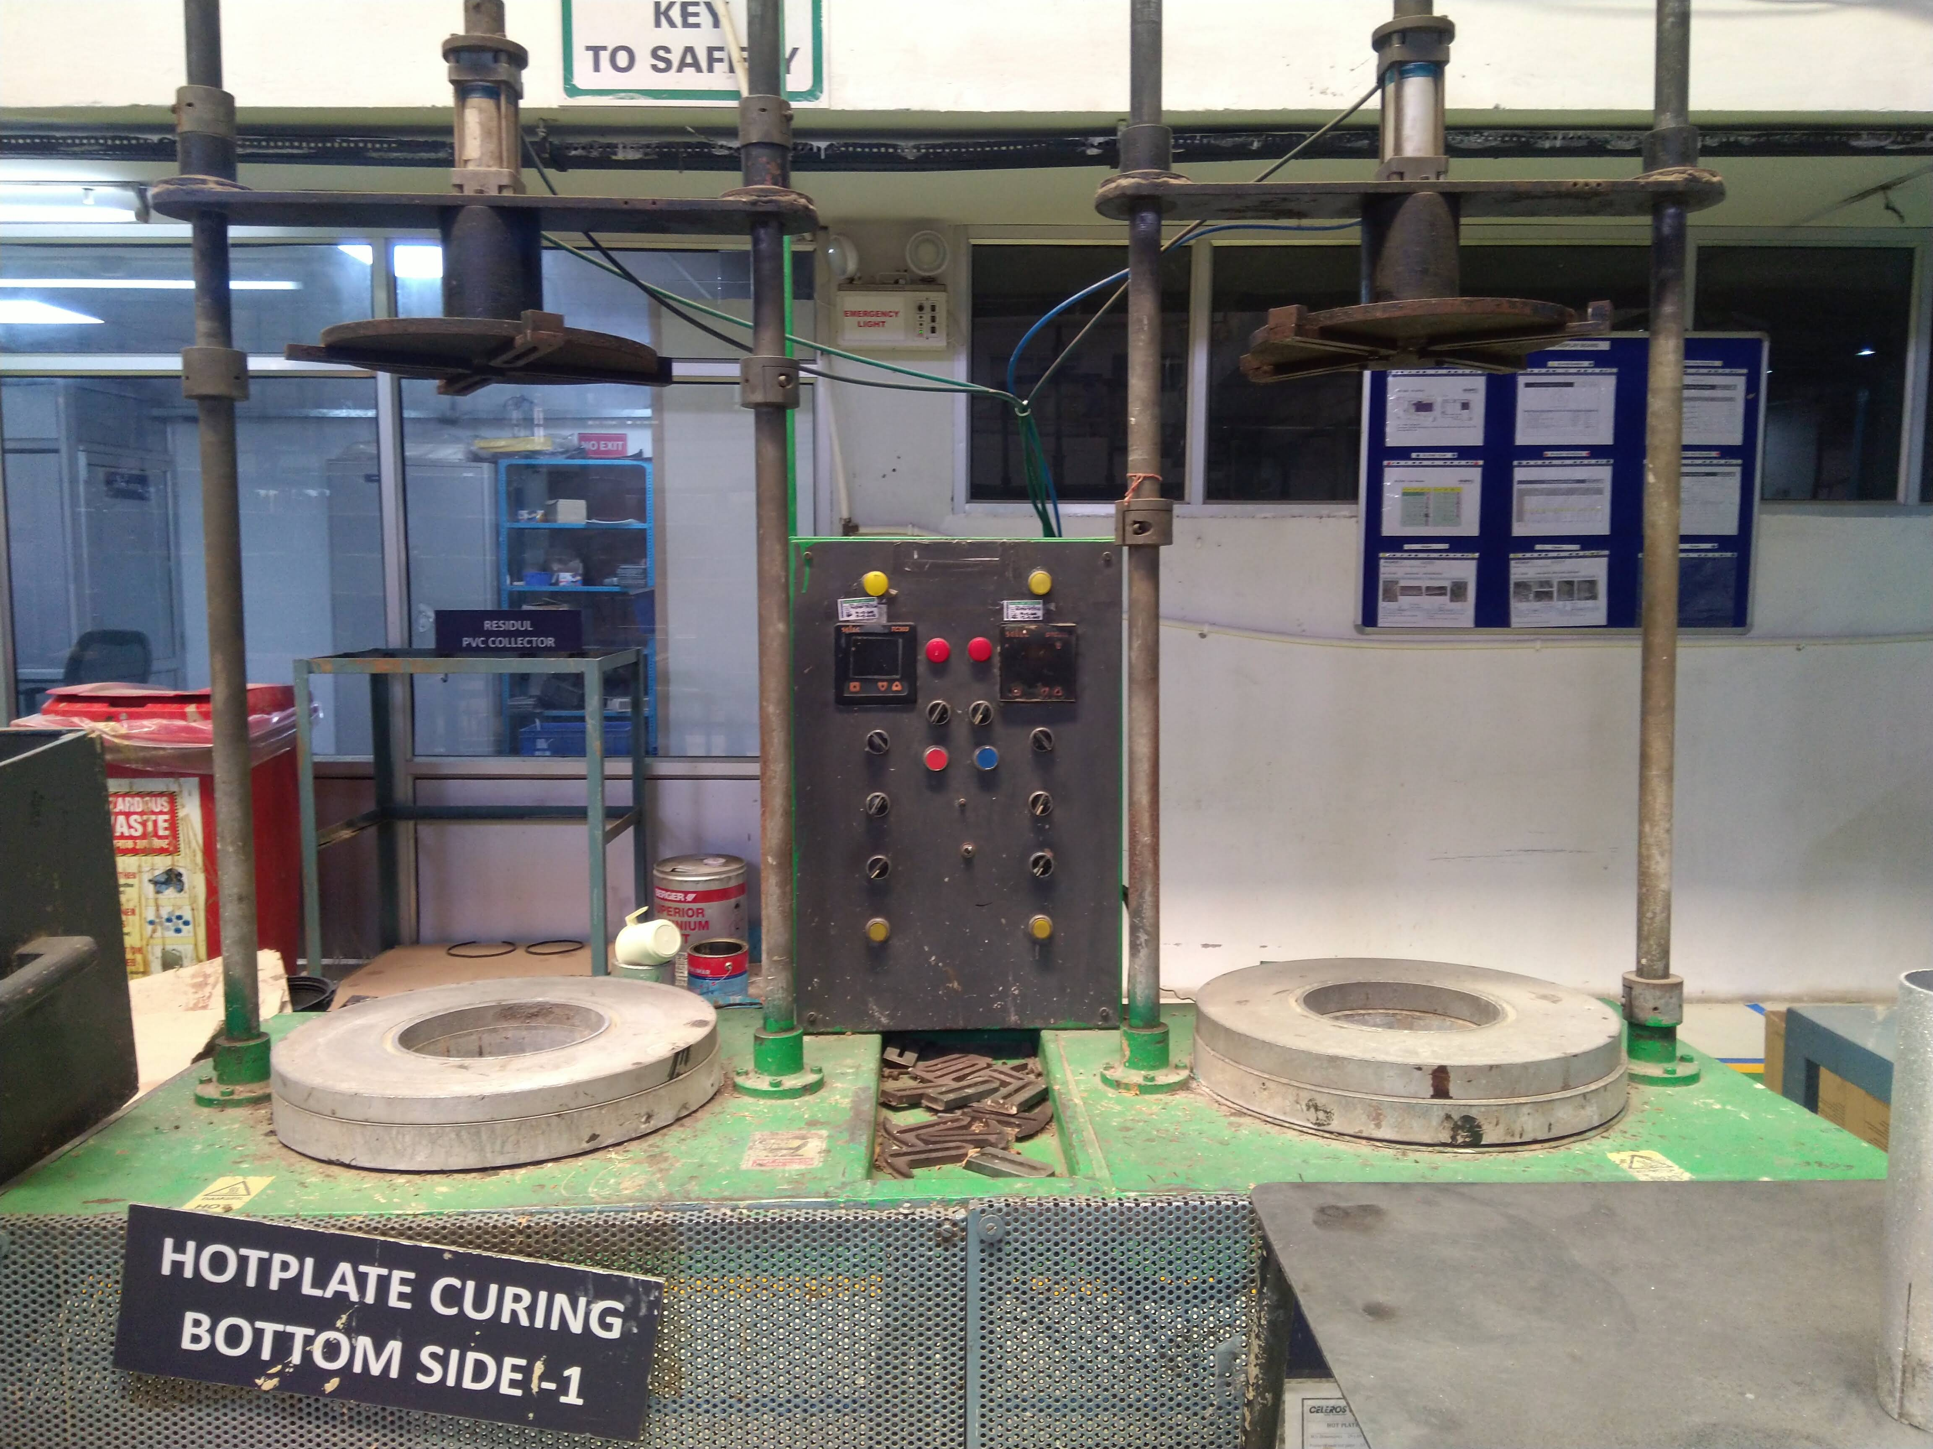
Present Situation-
Continued…

Slide 4
In the assembly line, a hot plate made of aluminium is provided which is heated through electricity.
The filter cap filled with adhesive is made to sit on the hot plate
As soon as it reaches the required temperature (approx. 270C), it is baked accordingly.

Slide 5
Problem faced-
A lot of power generated is wasted in heating up and raising the temperature of the hot plate every time.
The time required for the hot plate to reach the particular temperature is very long(1-1.5hr) and results in a lot of waste and idle time for the workforce.

Slide 6
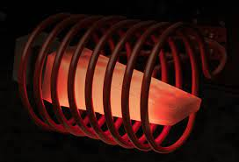
Solution Provided-
Introducing the concept of Direct Induction

Slide 7
Induction System
The Induction System used here can be divided in 3 main components:-
The Power unit
The Work head
The Heating coil
Let’s dig in a bit deeper in its working….

Slide 8
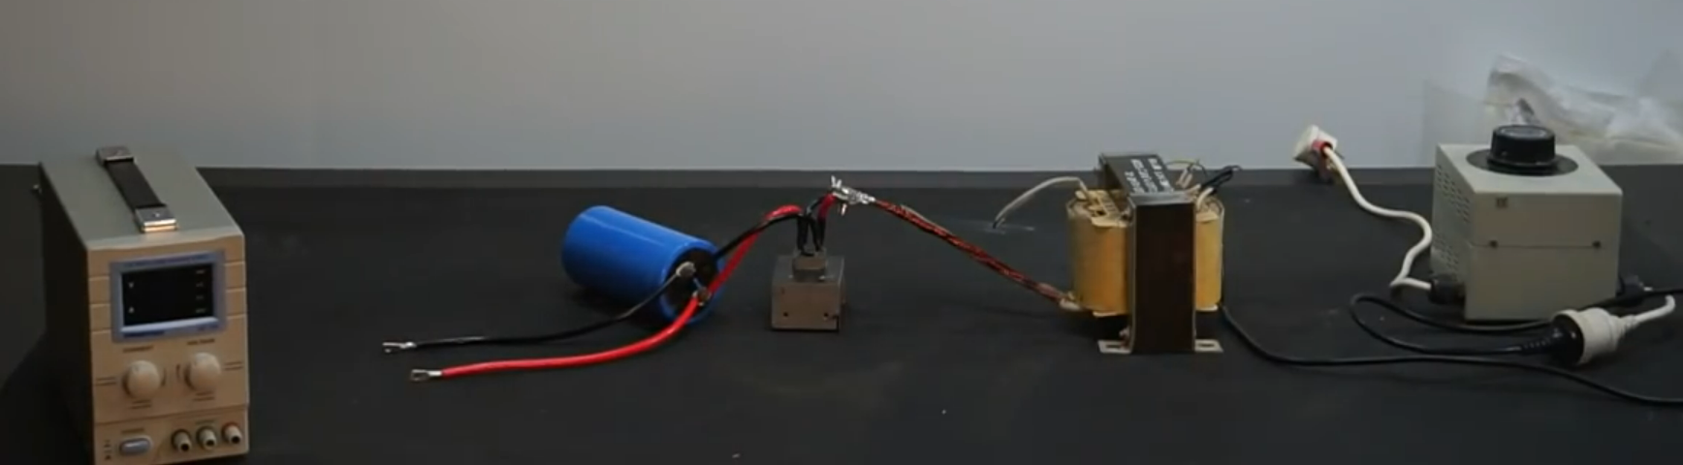
The Power Unit
The DC power supply consists of a standard air or water cooled step-up transformer and a high voltage rectifier unit capable of generating voltages to power the oscillator. The unit needs to be rated correctly to supply the necessary current to the oscillator.
Further specifications are
discussed in the next slide…..

Slide 9
Specifications
A transformer is used to step down the main power supply to up to 65V Ac but adds a lot of current which is essential to the system.
6 gauge wires are used to connect this to full bridge rectifier which is rated for up to 70Amp of current. Here the system is converted into a DC power supply.
Current needs to be supported by a massive capacitor of 35000 micro Farads.
A variac is connected to the system to vary the power supply and regulate the temperature of filter cap .

Slide 10
The Work Head
Usually the work heads use power inverters to produce high frequency AC currents.
This system is costly.
So we try to make our own oscillator.
This contains a combination of capacitors and inductors to mate the power unit to the work coil.
The L-C oscillations of the capacitors and inductors produces the current for the coil.

Slide 11
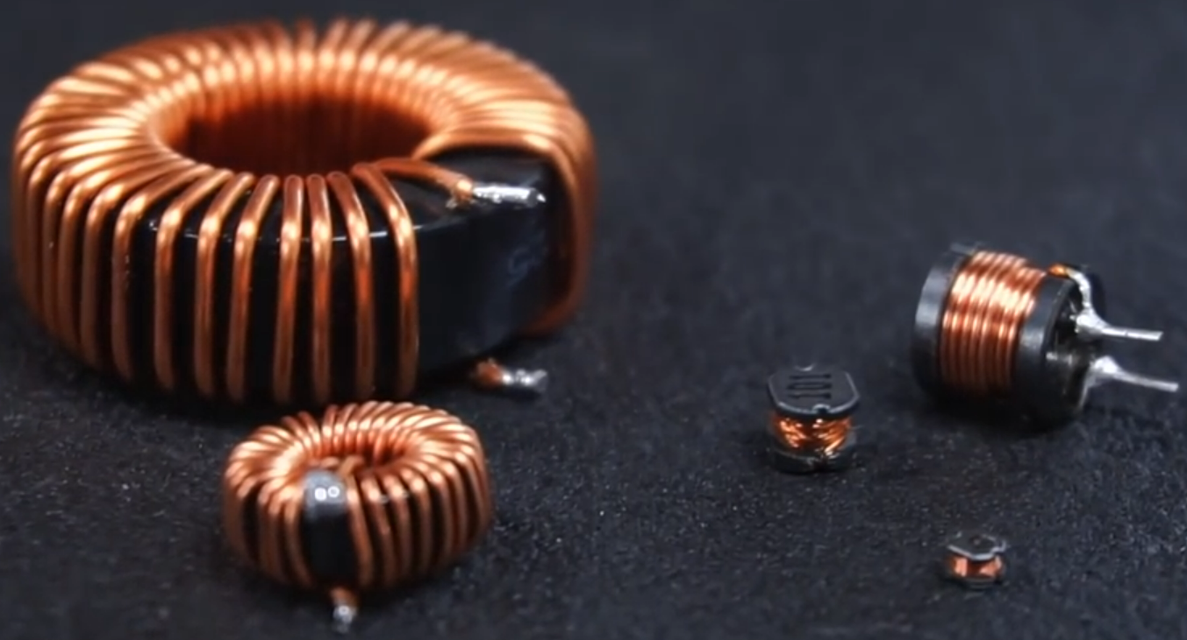
Capacitors and Inductors
A total of 14 Capacitors rated 330nF are connected in parallel to the circuit.
Inductors used to be made of double cored toroid using 12 gauge wires with around 18 turns.
While winding the inductors wires need to be kept to the inductor rings.
2 Inductors are made rated 60 microH each. All these specifications are under the inductor saturation point.

Slide 12
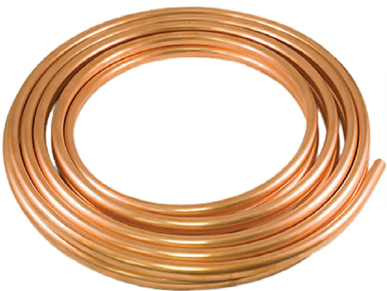
The Heating Coil
Here Pancake coils are used as it’s necessary to heat the workpiece from only one side, and it’s not possible to surround the part.
The flux from only one surface intersects with the workpiece.
The diameter of the pancake will be equal to the head of the filter to be heated =32.4cm.
A minimum of 6 turns of coils which should be increased if possible to decrease the form factor.
The coils need to be distant while being wound to prevent shorting themselves

Slide 13
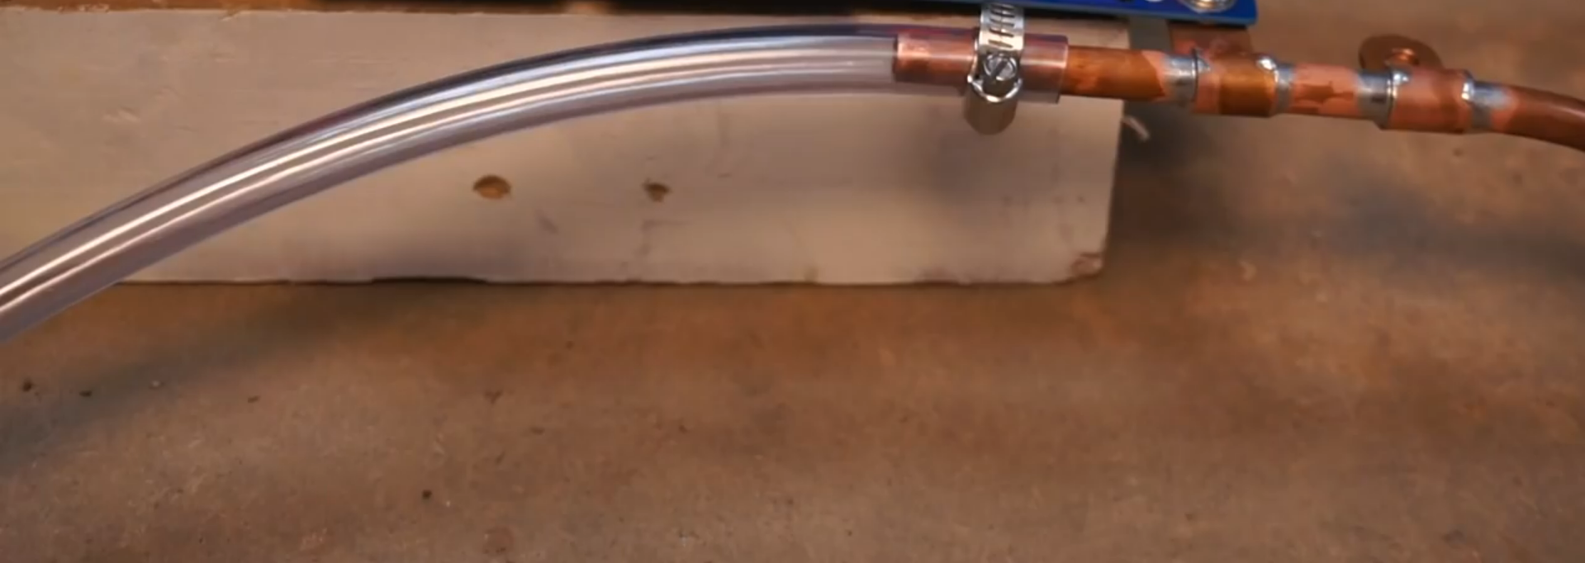
Temperature control of coil
The temperature of the copper coil should not get higher than 80C but if it does on a regular basis following method is to be employed:-
We chose hollow copper tubing to make our Heating coil.
It is because water can be made to flow inside them using PVC pipes which can be drained out to regulate the temperature of the coil.
Further advancements can be made using radiator-pump-cooler combo to cool the coil.

Slide 14
How to apply Direct Induction on existing machinery?
The heating coil is mounted and placed under a thin Porcelain ceramic tile.
The tile has a compressive strength of 20,000 psi or greater, and a breaking strength of over 275 lbf which can carry the weight of the entire filter(5.489kg).
A high frequency AC current is made to pass through the coil which induces heat inside the end cap.
The end cap is heated at a temp of 270C at about 7-8 min before unloading.

Slide 15
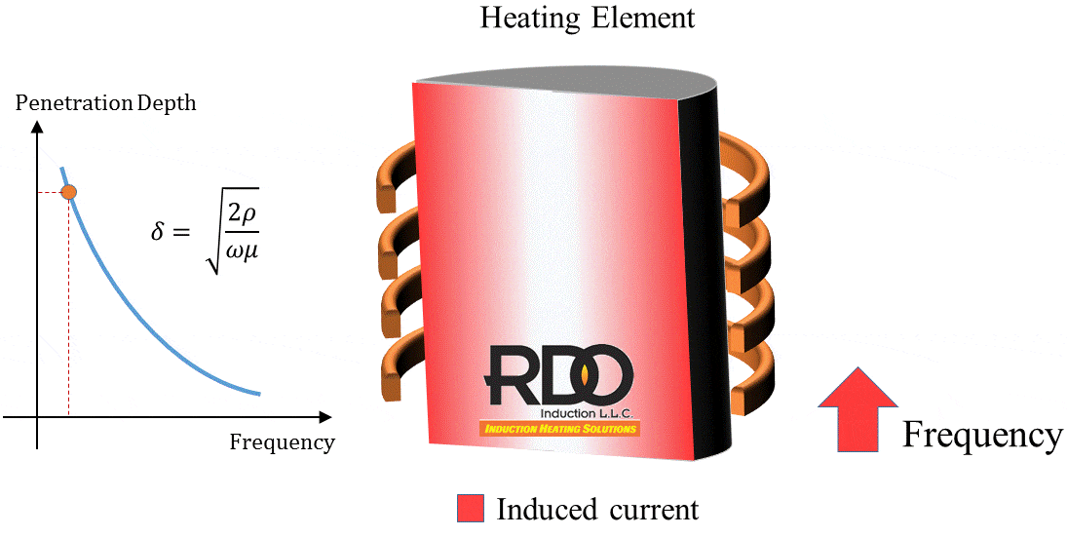
Depth of penetration and frequency
It is a critical factor.
If the eddy currents do not penetrate the wall thickness of the tube, the heating may not be uniform.
The average thickness of filter caps is 1.2cm.
So a sweet spot in current frequency is to be regulated for most efficient heat generation on through filter cap.
At 10kHz eddy current depth of penetration in mild steel is 2.09mm.

Slide 16
Power rating and other specifications
SNo :- | 1 | 2 | 3 | 4
Input Voltage (V) :- | 9.5 | 14 | 41.2 | 54.6
Current Drawn (A) :- | 10 | 15 | 10.4 | 27.1
Power (W) :- | 95 | 210 | 428.48 | 1479.66
As the metal heats up the value of current drawn will come to a constant and then drop as the internal resistance of the metal decreases.
The system will be rated for 1.8kW. The material being mild steel and not a pure ferrite-magnetic material, it is assumed to draw more power to heat up.
Efficiency of coupling between the windings is inversely proportional to the square of distance between them.
To maximise the coupling, the distance between the coil and the filter cap should vary between 0.75 inches and 1.75 inches hence the ceramic tile should be designed accordingly within this range.

Slide 17
Advantages incurred
SNo. | Before Induction system | After Induction system
1 | It took 1hr (approx.) for the hotplate to acquire desired temp. | Temp. acquired momentarily— Production capacity increased
2 | Once switched on, had to remain on inspite of worker breaks | Can be switched on and off on whims Daily Power Saved
3 | Current system is rated 2kW | New System rated 1.8kW Reduced Power Consumption
4 | A bulk piece of aluminium hotplate heats up to create unsavoury and hot working conditions | Heat generated is localised into the end cap of filter Working conditions improved Lesser load on cooling units

Slide 18
References
https://www.ambrell.com/learn/what-is-induction-heating?hsCtaTracking=e6644f6a-4953-4244-96eb-cd858b8d8326%7C26187e5b-61c9-4457-baf6-d986ed93d641
https://www.uihm.com/english/What-is-Induction-Heating-and-induction-heating-principle-1-31-15.html
An ECT testing by Asst. Professor Vishnu Shankar(RSET)
http://bit.ly/3dZCDEy
The foremen and technicians of Celeros

